Slide 1

Hybrid General Meeting
Manual and
Frequently Asked Questions
ASML Holding N.V.
25 March 2020

Slide 2
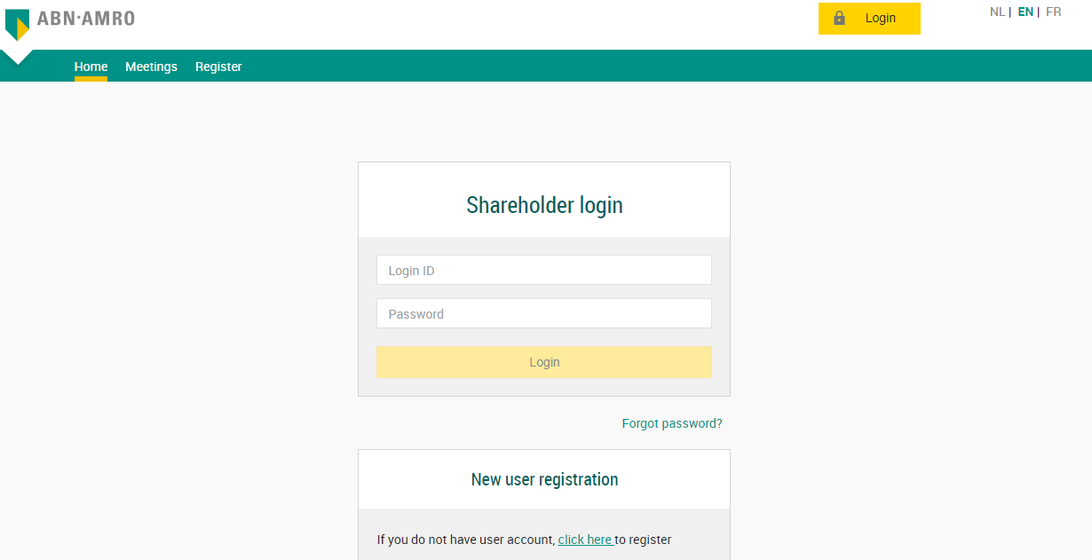
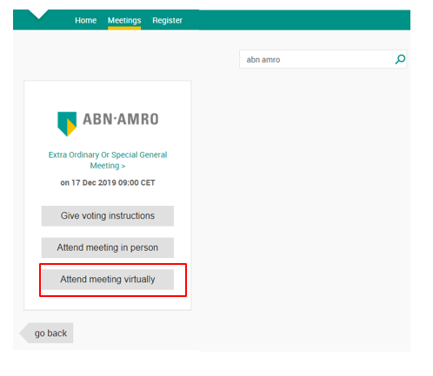
Login procedure pre Close of Registration
Annual General Meeting of Shareholders
Before Wednesday 15 April 2020, 17:30 CET
Click here to login to the shareholder portal and click login
Select the recent meeting of ASML Holding N.V. and select “Attend meeting virtually”
Annual General Meeting of Shareholders >
On 22 April 2020 14:00 CET

Slide 3
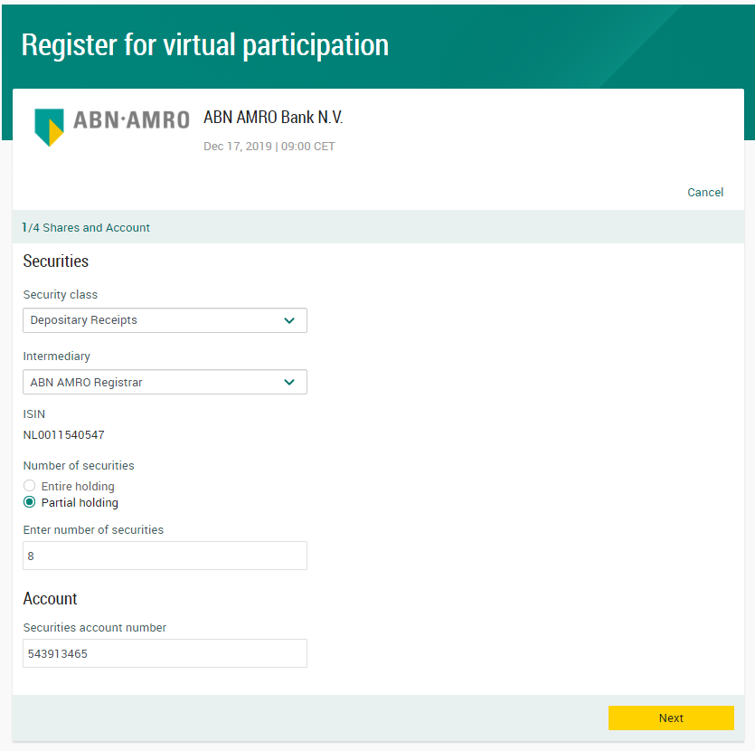

Login procedure pre Close of Registration
Before Wednesday 15 April 2020, 17:30 CET
Fill in all the details of registration for this meeting
NL0010273215

Slide 4
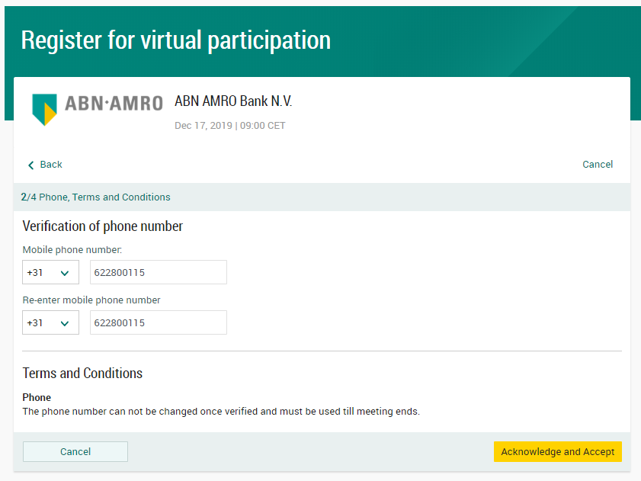
Login procedure pre Close of Registration
Before Wednesday 15 April 2020, 17:30 CET
Fill in phone number which will be used for 2 factor authentication

Slide 5
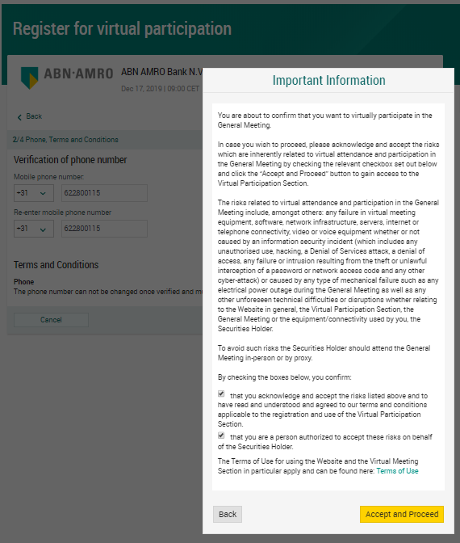


Login procedure pre Close of Registration
Before Wednesday 15 April 2020, 17:30 CET
Notification will be displayed with highlighted risks and terms of use
(including reference to ABN AMRO’s policy)

Slide 6
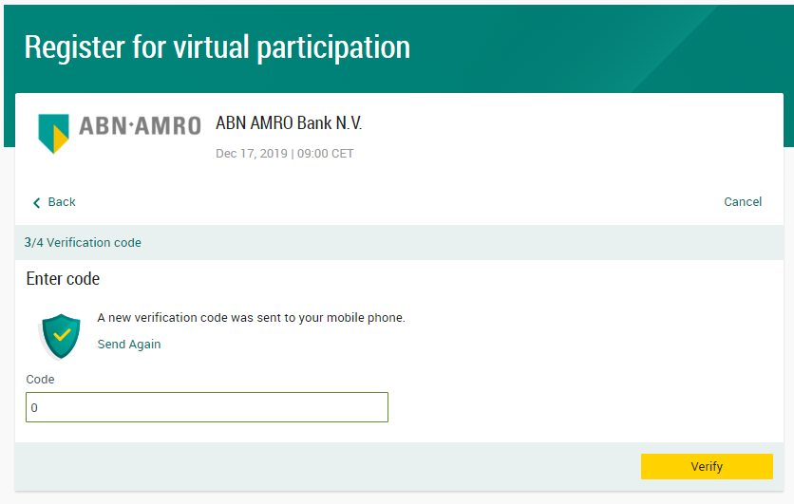
Login procedure pre Close of Registration
Before Wednesday 15 April 2020, 17:30 CET
Key in the one-time-passcode as received on your mobile phone

Slide 7
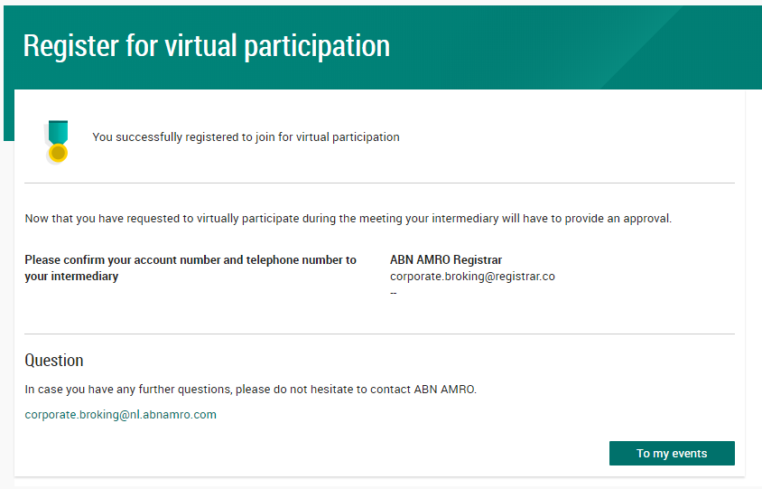
Login procedure pre Close of Registration
Before Wednesday 15 April 2020, 17:30 CET
Your intermediary will further process your request

Slide 8
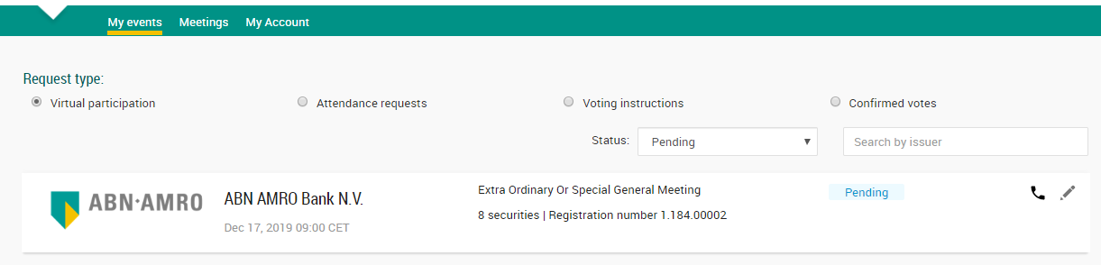
Login procedure pre Close of Registration
Before Wednesday 15 April 2020, 17:30 CET
A created request can be seen in My Events (observe pending state)
Annual General Meeting of Shareholders

Slide 9
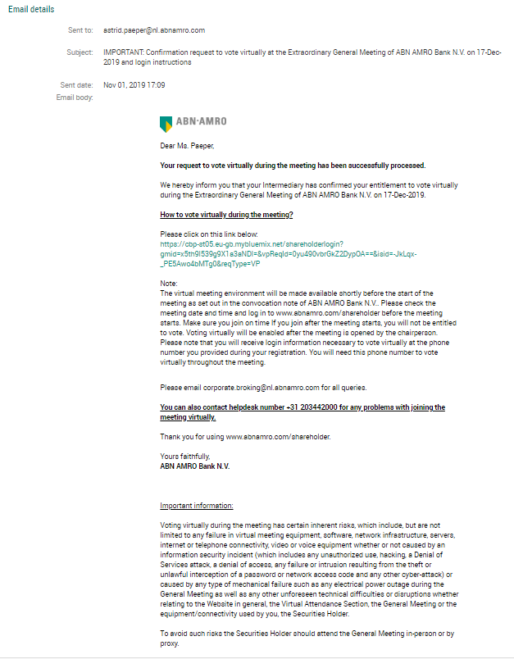
Login procedure pre Close of Registration
Before Wednesday 15 April 2020, 17:30 CET
April 15, 2020 16:00
Once approved by the intermediary, a shareholder will receive a confirmation mail

Slide 10
Login procedures at the day of the meeting
Before 14:00 CET on Wednesday 22 April 2020
Go to abnamro.nl/evoting
Click here to login to the shareholder portal and click login

Slide 11
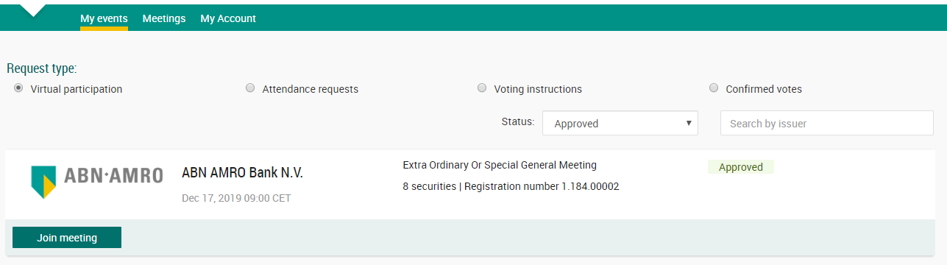
Login procedures at the day of the meeting
Join the meeting in My events

Slide 12
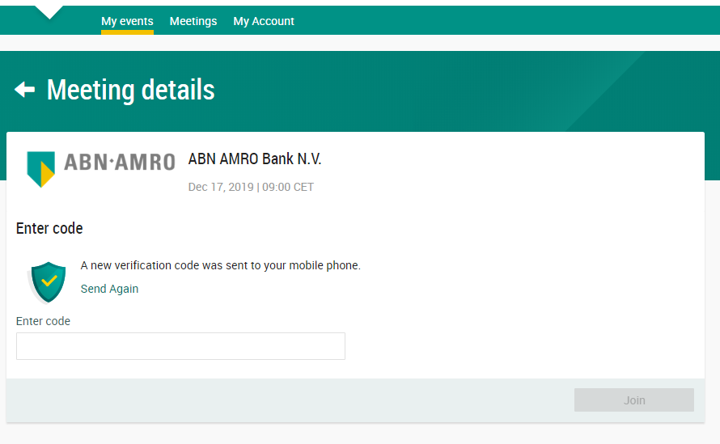
Login procedures at the day of the meeting
Key in the one-time-passcode as received on your mobile phone

Slide 13
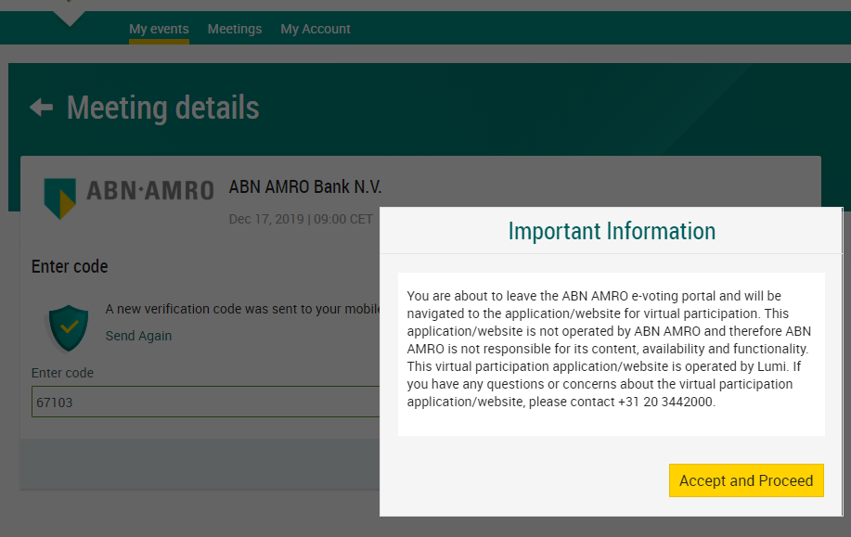
Login procedures at the day of the meeting
Successful one-time-passcode validation, notification will be shown. Please accept to proceed

Slide 14
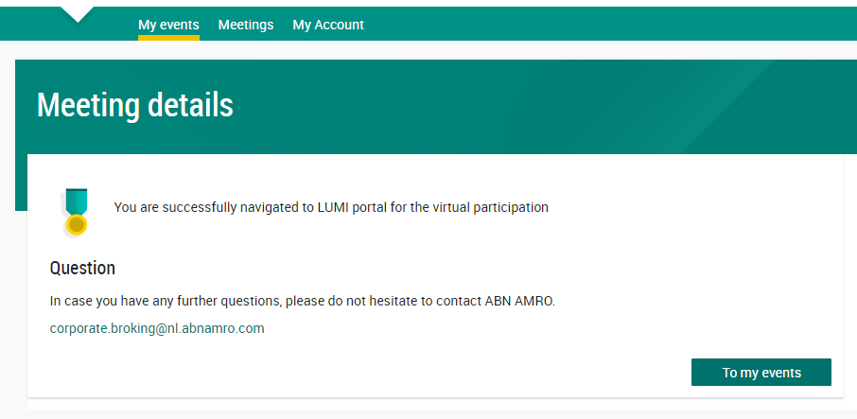
Login procedures at the day of the meeting
Successfully navigated to LUMI portal

Slide 15
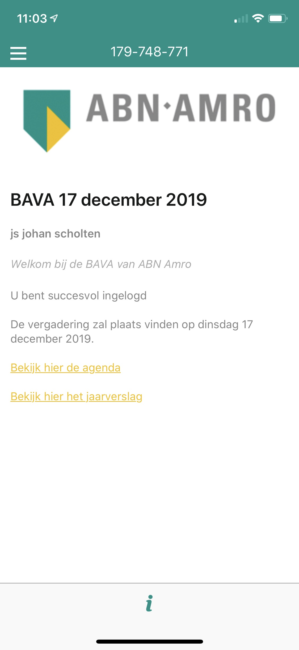
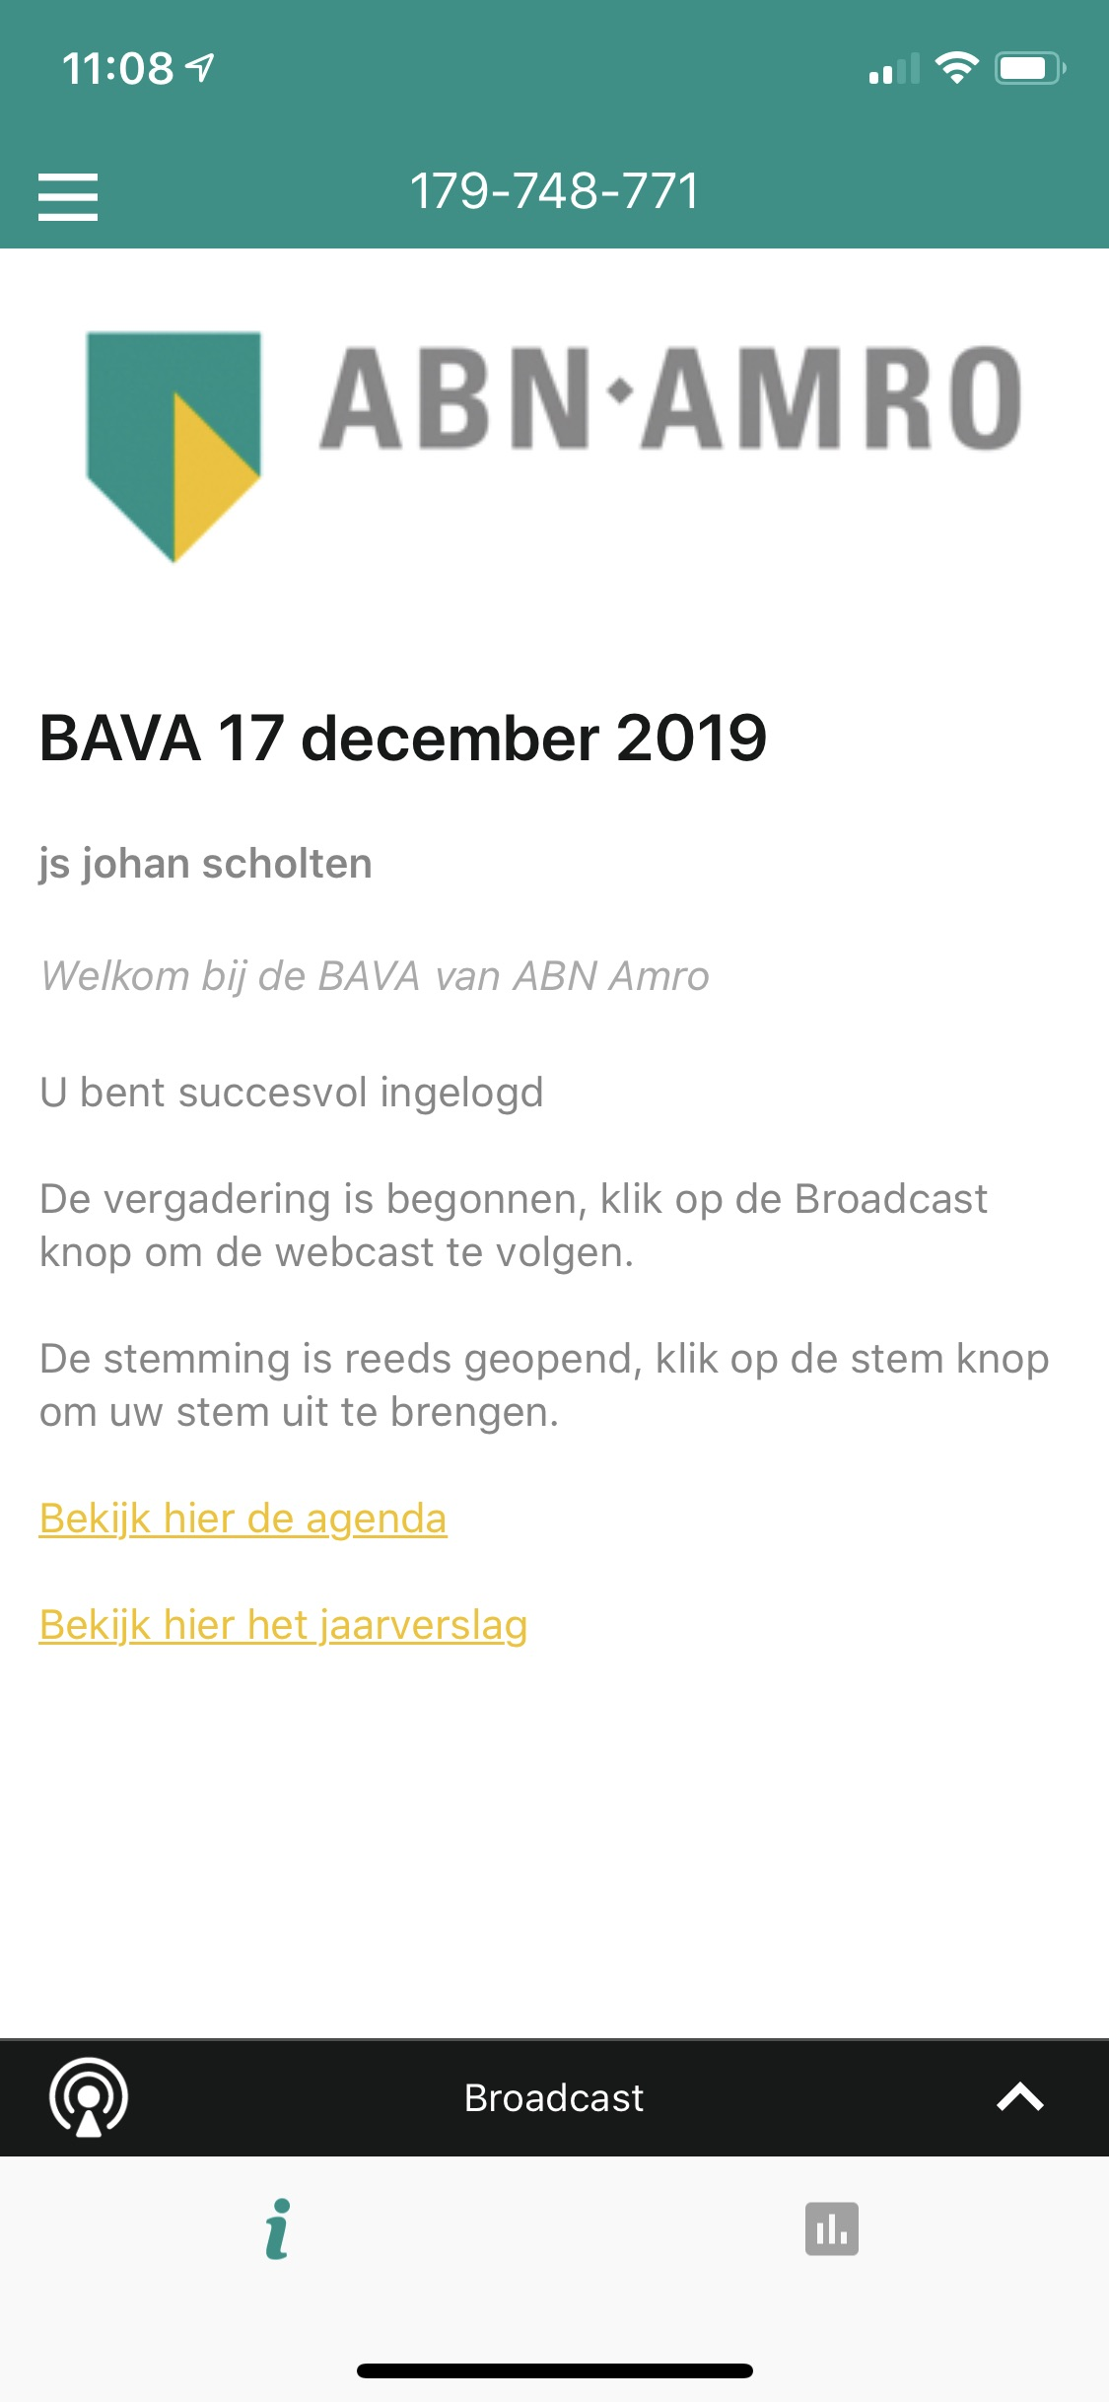
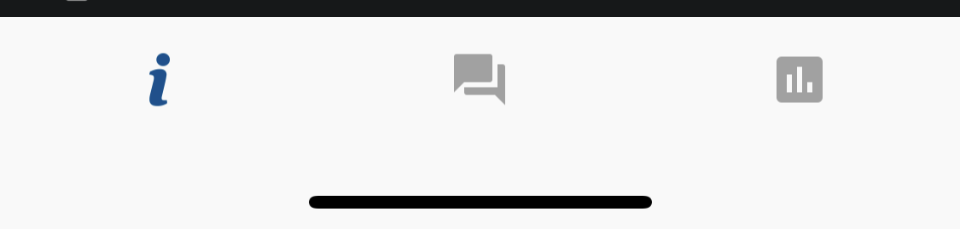
Login procedures at the day of the meeting
13:30 – 14:00 CET registration open
14:00 Follow the webcast
AGM 22 April 2020
AGM 22 April 2020
AGM 22 April 2020
Click here
to submit your question
Click here
for webcast

Slide 16
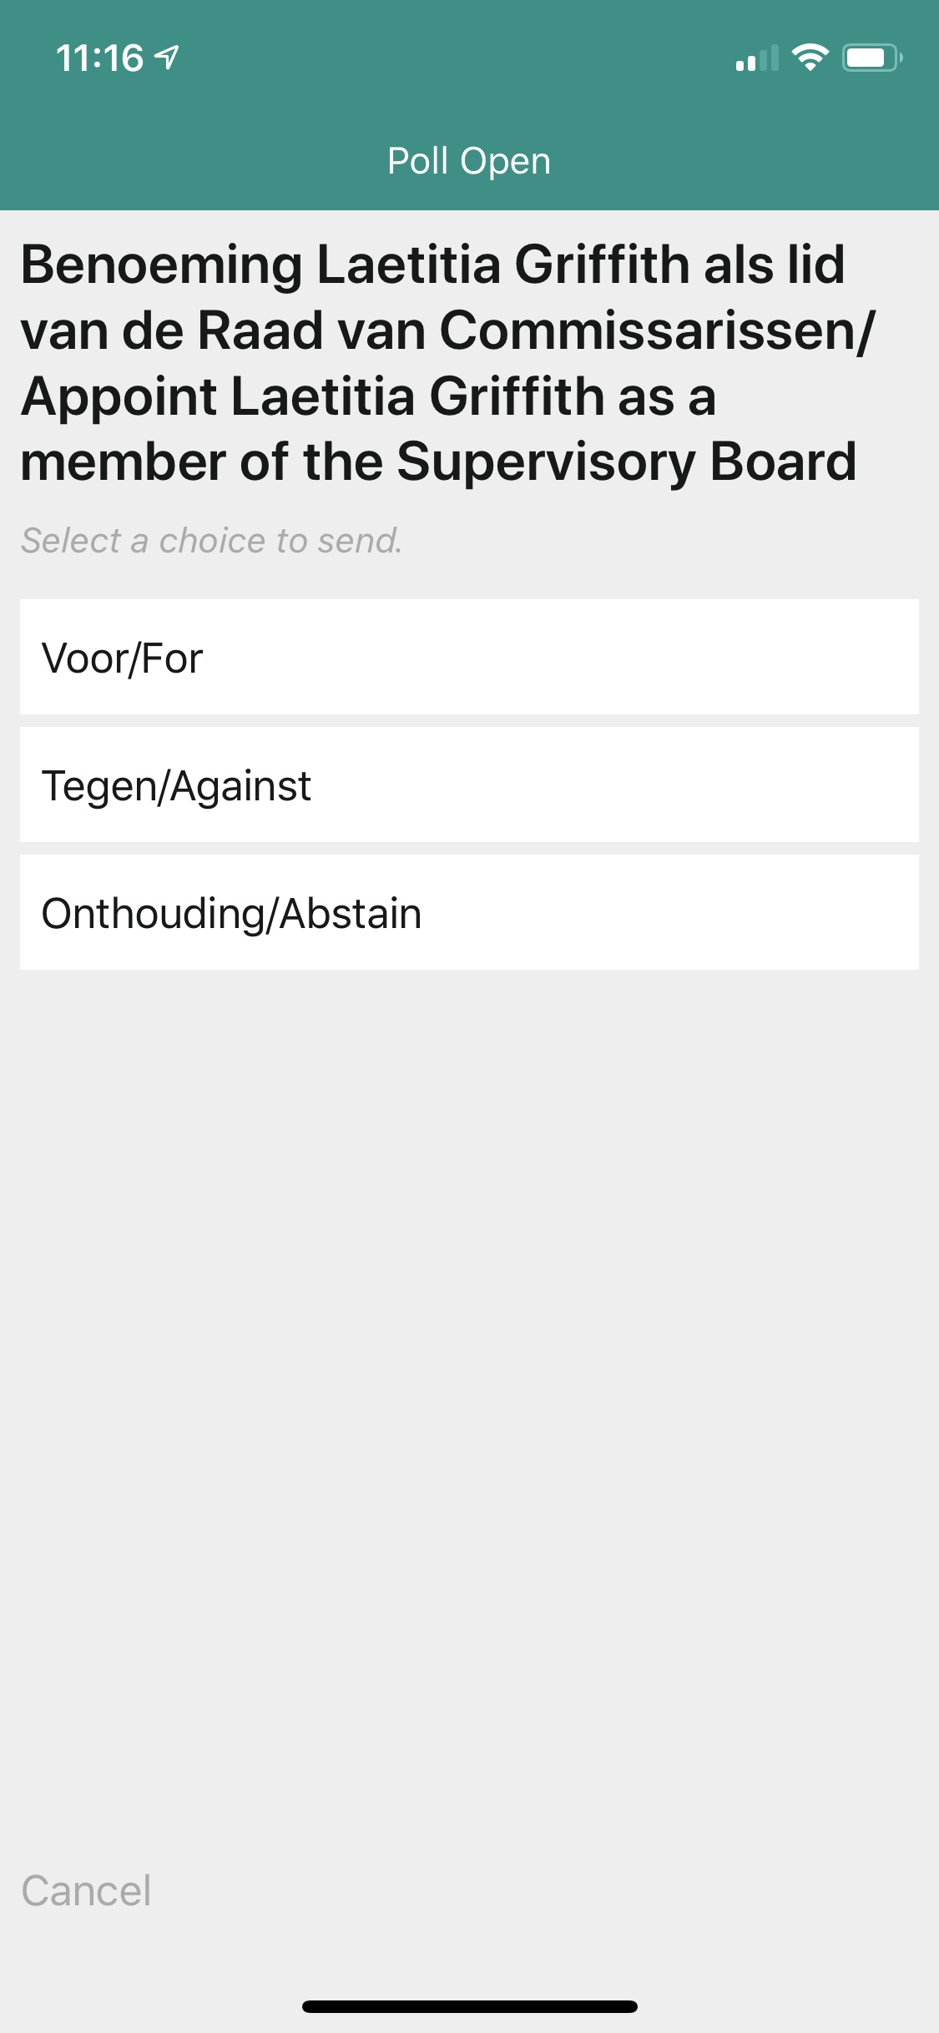

Virtual voting procedures at the day of the meeting
14:00 Voting is open
Please vote on all agenda items
This feature will be open during the AGM
Proposal to reappoint Ms. A.P. Aris as member of the supervisory board/ Voorstel tot herbenoeming van mevrouw A.P. Aris als lid van de raad van commissarissen
AGM 22 April 2020
Click here
to vote

Slide 17
Frequently asked questions
registration process
Q: How can I register to participate as a virtual shareholder at the ASML Hybrid Meeting?
A: As an ASML shareholder, you will first need to create a profile via www.abnamro.com/evoting , where you are requested to provide your mobile phone number and custody account number.
Q: Where can I login to participate in the Hybrid Meeting as a virtual shareholder?
A: You can participate via the ABN AMRO platform and login via www.abnamro.com/evoting .
Q: I don’t know my login details for the ABN AMRO platform?
A: You can easily request a new password via the website www.abnamro.com/evoting or contact ABN AMRO via: corporate.broking@nl.abnamro.com.

Slide 18
Frequently asked questions
registration process
Q: I registered myself to attend the Hybrid Meeting in person, can I also participate online in case I can’t attend the meeting physically?
A: Changing your attendance is possible until the Close of Registration, Wednesday 15 April 2020, 17:30 CET as stated on www.abnamro.com/evoting . After the registration deadline you can’t change your attendance.
Q: The ABN AMRO platform isn’t allowing me to login, what should I do?
A: Please contact ABN AMRO at corporate.broking@nl.abnamro.com or by telephone +31 (0)20 344 200.
Q: Can I test if I can get into the virtual environment ahead of the Hybrid Meeting?
A: Yes, you can do so after the Close of Registration, following the guidelines on www.abnamro.com/evoting . Should you face difficulties, please contact corporate.broking@nl.abnamro.com or by telephone +31 (0)20 344 200.
Q: How do I know if my bank has approved my registration for the Hybrid Meeting?
A: You will receive a confirmation from ABN AMRO by email. This might take a few minutes. In case the confirmation lakes longer than that, please do not hesitate to contact ABN AMRO via corporate.broking@nl.abnamro.com or by telephone +31 (0)20 344 200. We advise that you already use the testing period before the day of the Hybrid Meeting to test your access to the platform.

Slide 19
Frequently asked questions
registration process
Q: I haven’t received an email from ABN AMRO, what should I do?
A: Please contact ABN AMRO via corporate.broking@nl.abnamro.com or by telephone +31 (0)20 344 200.
Q: I have already registered for online participation at the Hybrid Meeting, but now I would like to participate in-person or through a proxy. Is that possible?
A: Yes, as long as you make this change before the Close of Registration, Wednesday 15 April 2020 17:30 CET. As further specified in the convocation of the Hybrid Meeting and as stated on www.abnamro.com/evoting.
Q: As of which moment can I login to the Hybrid Meeting?
A: You can login within a time frame of 30 minutes before the start of the Hybrid Meeting. Once you have done so you are counted as a shareholder attending the Hybrid Meeting, even if you leave before the start of or any time during the Hybrid Meeting (whether or not due to an internet connection failure).

Slide 20
Frequently asked questions
shareholder meeting
Q: How can I follow the Hybrid Meeting?
A: You will be able to follow the meeting via webcast via the link that will be published on www.asml.com/agm2020 or in the virtual environment via www.abnamro.com/evoting , or attend in person.
Q: Can I follow the Hybrid Meeting if I’m not a shareholder?
A: Yes, to follow the webcast please visit www.asml.com/agm2020 and click on the webcast link, but you cannot vote.
Q: What do I need to do to participate at the Hybrid Meeting?
A: You can submit your votes via proxy through ABN AMRO, attend the virtual meeting online, or attend in person. You can register via www.abnamro.com/evoting.
Q: When do I need to login when I want to attend and vote the Hybrid Meeting virtually?
A: You will be able to login from 30 minutes prior to the meeting until the meeting starts. The meeting will start at 14:00 CET on 22 April 2020.
Q: How do I know that I can vote during the Hybrid Meeting?
A: Once the Chairman has opened the shareholder meeting, you will be able to vote until the Chairman or the secretary of the meeting declares that the voting will be closed after the last voting item.

Slide 21
Frequently asked questions
shareholder meeting
Q: How do I know that I have voted at the Hybrid Meeting?
A: The application will confirm that your vote(s) has/have been received.
Q: Can I ask questions as a virtual participant of the Hybrid Meeting?
A: Yes, when participating online you will be able to follow the proceedings of the Hybrid Meeting, vote and ask questions. Shareholders are only allowed to submit follow-up questions to answers that have been provided prior to or during the Hybrid Meeting.
Q: Can I also vote in advance of the Hybrid Meeting?
A: Yes, you can by giving a proxy voting instruction via www.abnamro.com/evoting .
Q: I have already voted through proxy on the ABN AMRO Website, do I need to vote again?
A: No, your proxy voting instruction will remain valid.
Q: I have already voted through proxy on the ABN AMRO Website, can I change my vote during the Hybrid Meeting?
A: If you grant a proxy voting instruction your vote has, in fact, been made before the meeting takes place and you will only be able to change your voting instruction until Close of Registration, Wednesday 15 April 2020, at 17:30 CET.

Slide 22
Frequently asked questions
shareholder meeting
Q: I have already voted through proxy on the ABN AMRO Website, can I still follow the Hybrid Meeting?
A: Yes, you can via the webcast available on www.asml.com/agm2020.
Q: I am unable to vote.
A: Once the Chairman has opened the shareholders meeting, you will be able to vote until the close of the voting procedure if you are a registered shareholder. Press the voting button to submit your votes. Please make sure you are connected to the internet.
Q: How can I submit a vote?
A: During the meeting you will be able to vote. Press the voting button to submit your votes. When selecting the button of your choice your vote will be cast automatically. Please submit your votes on all resolutions. You will see a confirmation in your screen.
Q: How can I change my vote?
A: You will be able to amend your votes during the meeting, you will be able to vote until the Chairman or the secretary of the meeting declares that the voting will be closed after the last voting item.

Slide 23
Frequently asked questions
General questions
Q: I appreciate the possibility to participate online at the Hybrid Meeting, I wonder how ASML ensures that online participation will be without issues?
A: The application ASML uses is relatively new, at least in the Netherlands. In other countries, such as the United States of America and United Kingdom, hybrid shareholder meetings, and even virtual-only shareholder meetings, are more common. ASML offers the application to shareholders through third parties that have gathered experience with organizing these hybrid and virtual shareholders’ meetings outside the Netherlands. But even though ASML has given its best efforts to ensure that shareholders are offered a best-in-market service, it cannot guarantee that shareholders may experience issues that are common to any first generation innovative application.
Q: Is the Hybrid Meeting the first step that ASML takes in moving towards a virtual-only shareholders’ meeting?
A: Dutch law still prescribes that a physical shareholders’ meeting must be held. As long as this rule has not been changed, which is not likely to happen in the coming years, ASML will not switch to virtual-only shareholders’ meetings. One should be aware, however, that times are changing quickly these days and the development of online tools is an ongoing process.

Slide 24
Frequently asked questions
general questions
Q: Will all upcoming shareholders’ meetings of ASML be in hybrid form, i.e. open for online and in-person participation?
A: ASML may decide, at its own discretion, for each shareholders’ meeting separately whether the possibility of online participation will be provided next to in-person access.
Q: Why should I choose for online participation when I can grant a proxy voting instruction as I did before?
A: When you participate online, you will be able to take into account the deliberations (just before and) at the general meeting before you decide how to vote. If you grant a proxy voting instruction your vote has, in fact, been made before the meeting takes place and you will only be able to change your voting instruction until Close of Registration, Wednesday 15 April 2020, at 17:30 CET.
Q: What will be done with all my personal data which I am asked to provide when opting for online participation?
A: ABN ARMO will process your personal data and adheres to its GDPR policy, which can be found on www.abnamro.com/en/footer/privacy-statement.html
Q: Are there any rules and conditions set by ASML that apply to the Hybrid Meeting?
A: Yes, we refer to the Policy regarding the Hybrid General Meeting of Shareholders which van be found on www.asml.com/agm2020. If you participate online, you should have read this policy.

Slide 25
Frequently asked questions
general questions
Q: I don’t have a smartphone, tablet or pc. Will I be able to participate the Hybrid meeting?
A: Unfortunately, in that case the shareholder can’t join the AGM virtually. If you are registered for the meeting, you can always attend the Hybrid Meeting in person.
Q: My internet connection isn’t working properly. Will I be able to participate the Hybrid meeting?
A: You will need a working internet connection during the meeting. On your phone you can also use a mobile (3G/4G) signal if available, or use WiFi.
Q: My battery is almost empty. What do I do?
A: The shareholder is responsible for a properly functioning and charged device.
Q: What are the terms of use?
A: You can find the Policy regarding the Hybrid General Meeting of Shareholders on www.asml.com/agm2020. If you participate online, you should have read this policy.

Slide 26
Frequently asked questions
general questions
Q: How do I know this is a safe way to vote?
A: The website and portal provided through www.abnamro.com/evoting has been thoroughly tested by various parties.
Q: Which device should I use to participate online at the Hybrid Meeting?
A: You can participate at the Hybrid Meeting with any device that has a working internet connection and successfully logged in to the virtual environment via www.abnamro.com/evoting. Please make sure to have installed the latest version of your internet browser, Chrome, Firefox, Internet Explorer 11 and 10, Edge and Safari.

Slide 27
Frequently asked questions
general questions
Q: The device that I will use for online participation has a camera installed: will, or can, I be made visible in the Hybrid Meeting to other participants or anyone else?
A: No, that will not be the case.
Q: When I participate online, will other shareholders be informed that I am participating or do they have the possibility to know that?
A: No. You will be registered on the registration list of all shareholders attending the Hybrid Meeting in accordance with the provisions of ASML's articles of association. A participating shareholder may request the Chairman to see the attendance list of the general meeting. The Chairman will decide whether this request will be honoured.
Q: Who can I contact if my question is not above?
A: You can contact ABN AMRO via email corporate.broking@nl.abnamro.com or by telephone +31 (0)20 344 200.

Slide 28
Frequently asked questions
exercise of rights
Q: Are my votes valid when leaving early? Can I re-join after I have left?
A: Yes, assuming you have logged in successfully prior to the start of the Hybrid Meeting this will not affect the votes casted until the moment you left. Re-joining the Hybrid Meeting after you’ve left is possible and you will also be able to vote upon items that have been put to vote in the meantime. The polls for all items are open during the Hybrid Meeting and closed after the last voting item on the agenda has been discussed.
Q: When there’s a failure in my network connection, or my device stops working during the Hybrid Meeting will I be able to login and continue to participate in the Hybrid Meeting once the connection has been restored?
A: Yes, assuming you have logged in successfully prior to the start of the Hybrid Meeting, you will be able to continue participating in the Hybrid Meeting after the network connection has been restored. You will also be able to vote on items that have been put to vote in the meantime. The polls for all items are open during the Hybrid Meeting and closed after the last voting item on the agenda has been discussed.
Q: Will I be able to ask questions or make any comments to the meeting during the Hybrid Meeting when I participate online?
A: No, when participating online you will only be able to follow the proceedings of the Hybrid Meeting and to vote. To submit questions or any comments during the Hybrid Meeting, you should attend the Hybrid Meeting in person.

Slide 29
Frequently asked questions
exercise of rights
Q: Are there any voting restrictions when participating online?
A: When participating online split-voting is not possible as it is not supported by the platform yet. In order to be able to use split-voting, you should attend the Hybrid Meeting in person or by proxy.
Q: I have registered for online participation, but have sold my shares after that. Can I still vote on these shares?
A: Yes, according to The Dutch law the 28th day before the day of the Hybrid Meeting is decisive for who will be able to vote at the Hybrid Meeting. As registration is only possible after that record date, the right to vote remains even if you have already sold your shares in the meantime.
Q: Will the possibility of online participation affect the proceedings at the general meeting?
A: At the Hybrid Meeting the usual proceedings for general meetings of ASML will be followed. However, the polls for all items are open during the Hybrid Meeting and closed after the Chairman or the secretary of the meeting declared that the voting is closed.

